Slide 1
Mary A. Marion
Personal Statement
Career Milestones

Slide 2
Introduction
My name is Mary A. Marion. I am an applied statistician who applies mathematical theory to my projects.
My tools include a statistics library and state of the art computer setup.

Slide 3
Academic Credentials
Nickname | School | Area
RIT | Rochester Institute of Technology College of Science | M.S. Applied Statistics 2023
KSU | Kansas State University College of Science | Statistics
UVA | The University of Virginia College of Arts & Sciences | Statistics
VT | Virginia Tech College of Science | Statistics
GMU | George Mason University College of Science and Engineering | Mathematics and Statistics
GWU | The George Washington University College of Arts & Sciences | M.S. Statistics 1976
AU | American University College of Arts & Sciences | Statistics
UNO | University of Nebraska at Omaha | B.A. Mathematics 1969
MU | Marquette University | Physical Therapy
CST | College of St. Teresa College of Arts & Sciences | Mathematics
IPE, stat.com | Institute for Professional Education, statistics.com | Statistics, predictive analytics
SAS | SAS Institute Inc. | 24 CEU in Statistics
PACKAGES | JMP, SPSS,MINITAB,DESIGN EXPERT, MATLAB, MATHEMATICA, R, RStudio | Statistics, DOE and Mathematics

Slide 4
Work Experience
Location: federal service, private industry
I use physical science and engineering data to resolve questions of product effectiveness.
I apply mathematical statistics to quality control, hypothesis testing, DOE and statistical analyses.
I do environmental risk assessment and biostatistical analyses.

Slide 5
Work Ethic
At RIT, my most recent academic endeavor,
we blended technology, mathematics, and
statistics to inspire problem solving through
creatativity and innovation.
I believe in teamwork, cooperation and
quality of work for your organization.

Slide 6
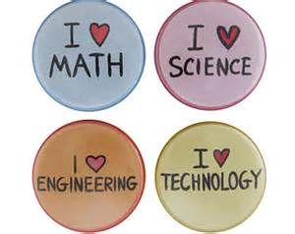
My Goal is Excellence in Statistics.
I believe this is best achieved by constant practice and the helping of others in their analyses and educational pursuits.

Slide 7
Summary
I am a bit nerdy, of straight sexual orientation, with a never ending interest in what makes things work.
I constantly study to develop and improve statistically based
analytical approaches for problem solving.
I balance my work with an interest in equestrian events
and lap swimming.
I enjoy family gatherings and outings.

Slide 8
The End

